Slide 1




Advanced Arduino Course
Prepared by: Qossay Abu Rida
IEEE Robotics and Automation Society

Slide 2
Agenda
Introduction
Sensors
Actuators
Communication
Examples

Slide 3
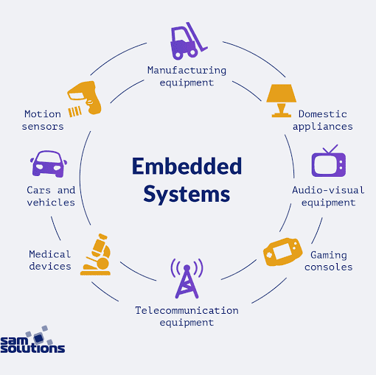
Introduction

Slide 4
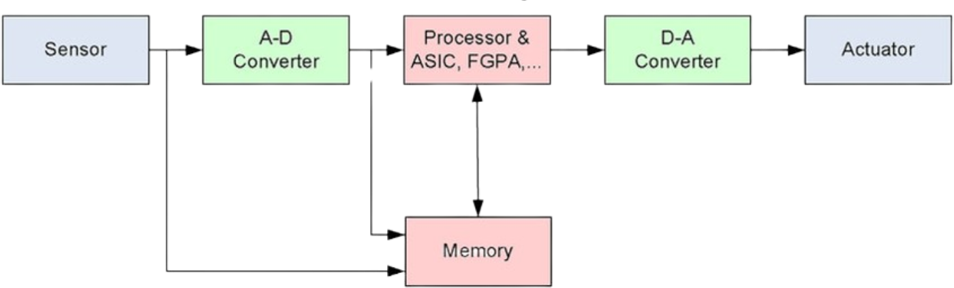
Embedded systems (Symbolic-Based)

Slide 5
Arduino Hardware
Arduino Boards
Microcontroller-based boards with various input/output capabilities.
Examples: Arduino Uno, Arduino Mega, Arduino Nano.
Key Components
Microcontroller: The brain of the board (e.g., ATmega328 on Arduino Uno).
Digital Pins: Used for digital input/output (e.g., LEDs, buttons).
Analog Pins: Used for analog input (e.g., sensors).
Power Supply: Can be powered via USB or external power source.
Communication Ports: Serial, I2C, SPI for interfacing with other devices.

Slide 6
ESP32 Hardware
ESP32 Overview
A low-power Wi-Fi and Bluetooth microcontroller with various input/output capabilities.
Developed by Espressif Systems, commonly used in IoT applications.
Key Components
Microcontroller: Dual-core Tensilica Xtensa LX6 processor with up to 240 MHz clock speed.
Digital Pins: Supports multiple GPIO pins for digital input/output operations.
Analog Pins: Features ADC (Analog-to-Digital Converter) and DAC (Digital-to-Analog Converter).
Power Supply: Operates at 3.3V, powered via USB or external Li-ion battery.
Wireless Connectivity: Built-in Wi-Fi (802.11 b/g/n) and Bluetooth (Classic & BLE) for wireless communication.
Communication Ports: Supports UART, I2C, SPI, PWM, and CAN protocols for external device interfacing.

Slide 7

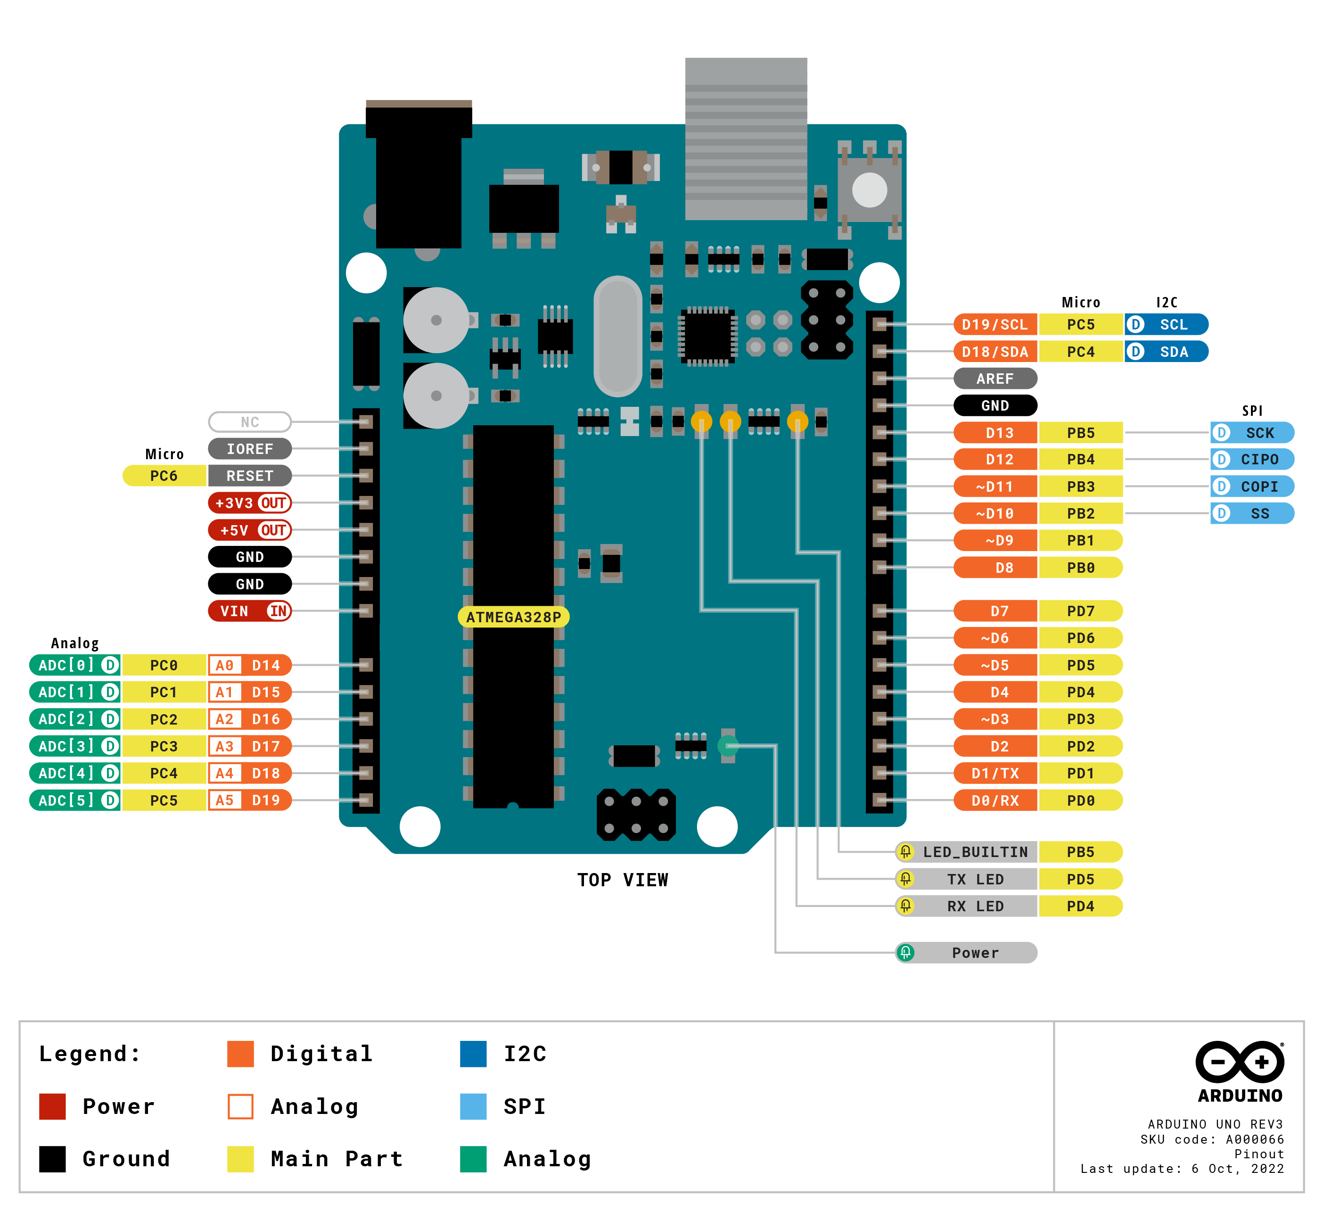
Arduino Uno board

Slide 8
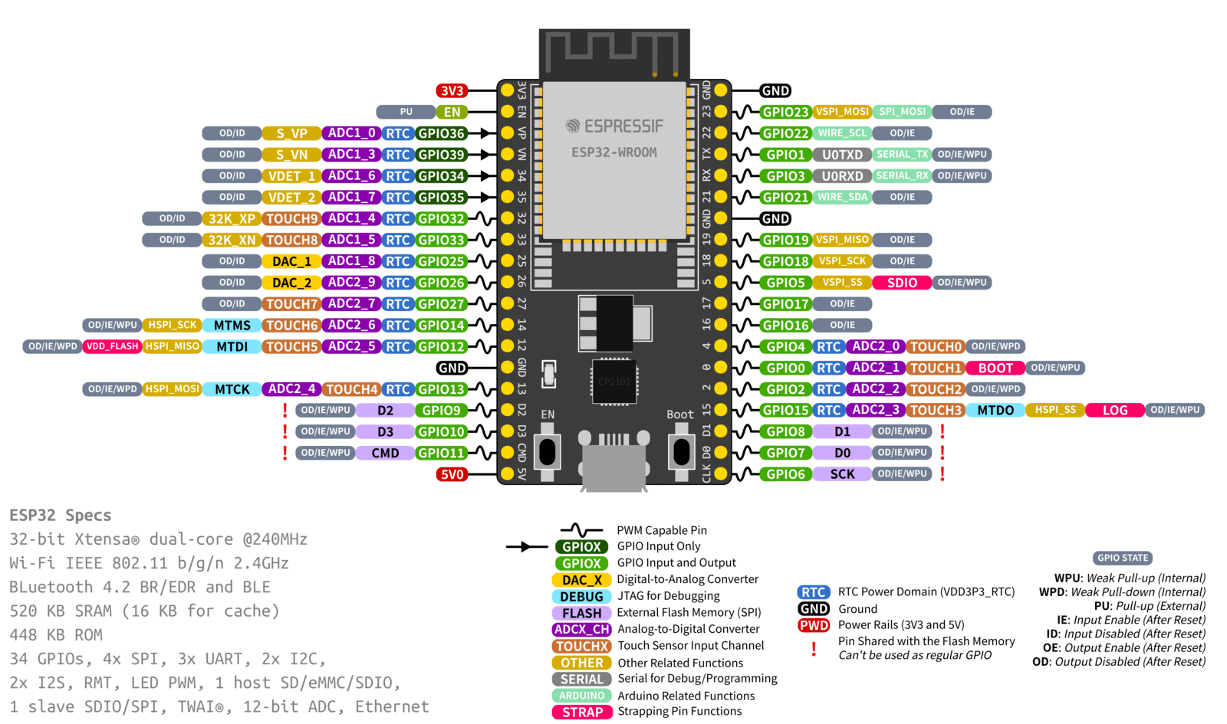
ESP-32 board

Slide 9
Arduino Software (use for Arduino UNO & ESP32)
Arduino IDE
Integrated Development Environment for writing, compiling, and uploading code to Arduino boards.
Available for Windows, Mac, and Linux.
Key Features
Code Editor: Write and edit Arduino sketches (programs).
Compiler: Convert sketches into machine code that the microcontroller can execute.
Uploader: Transfer the compiled code to the Arduino board via USB.
Serial Monitor: Communicate with the board and debug sketches using serial communication.
Programming Language
Based on C/C++ with simplified syntax and functions.
Uses libraries to add functionality (e.g., controlling motors, reading sensors).

Slide 10
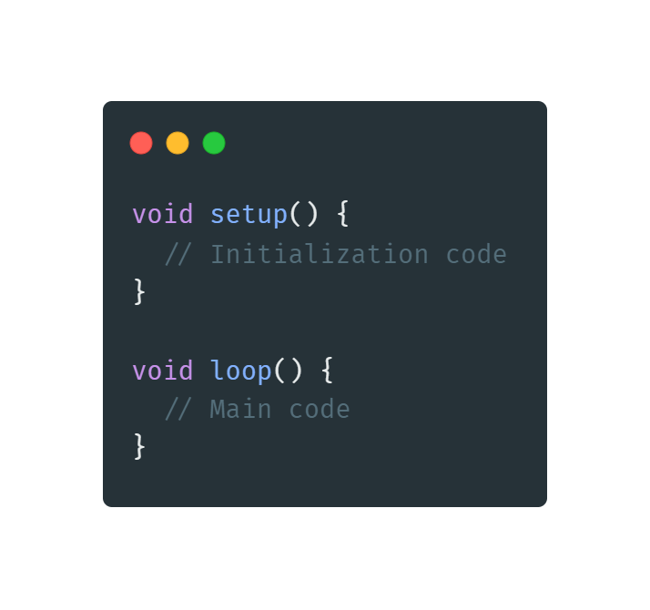
How to Program Arduino & ESP 32
Setup Function:
Purpose: Initializes settings.
Runs Once: This code runs once when the Arduino is powered on or reset.
Loop Function:
Purpose: Contains the main logic of the program.
Runs Repeatedly: This code runs in a loop after the setup function has completed.

Slide 11
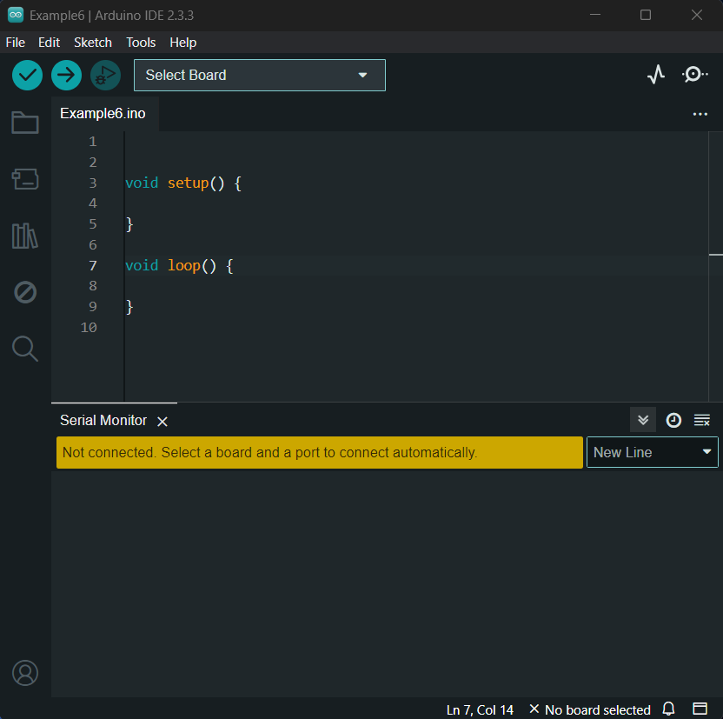
Arduino IDE simple sketch.

Slide 12
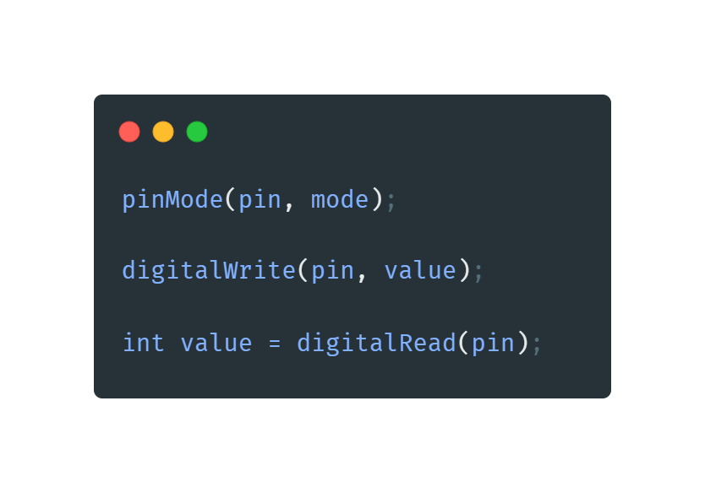
Common Functions Used in Arduino Programming
pinMode():
Purpose: Configures a specified pin to behave either as an input or an output.
digitalWrite():
Purpose: Sets a specified digital pin to HIGH or LOW.
digitalRead():
Purpose: Reads the value from a specified digital pin, either HIGH or LOW.

Slide 13
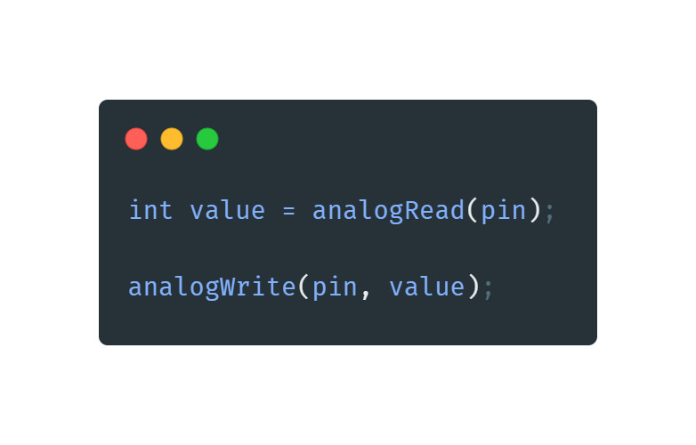
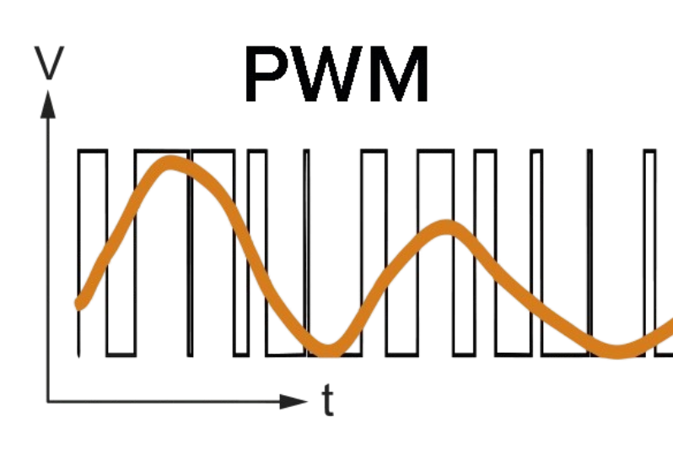
Common Functions Used in Arduino Programming
analogRead():
Purpose: Reads the value from a specified analog pin.
analogWrite():
Purpose: Writes an analog value (PWM wave) to a specified pin.

Slide 14
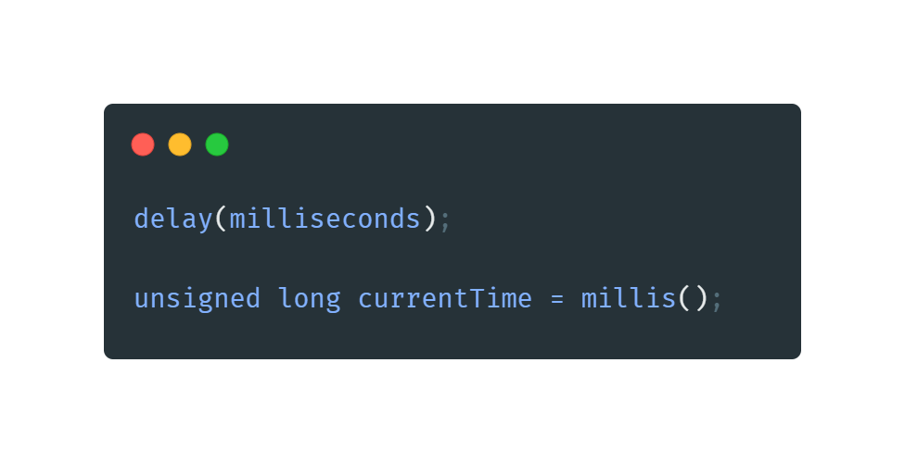
Common Functions Used in Arduino Programming
delay():
Purpose: Pauses the program for a specified number of milliseconds.
millis():
Purpose: Returns the number of milliseconds since the Arduino board began running the current program.

Slide 15
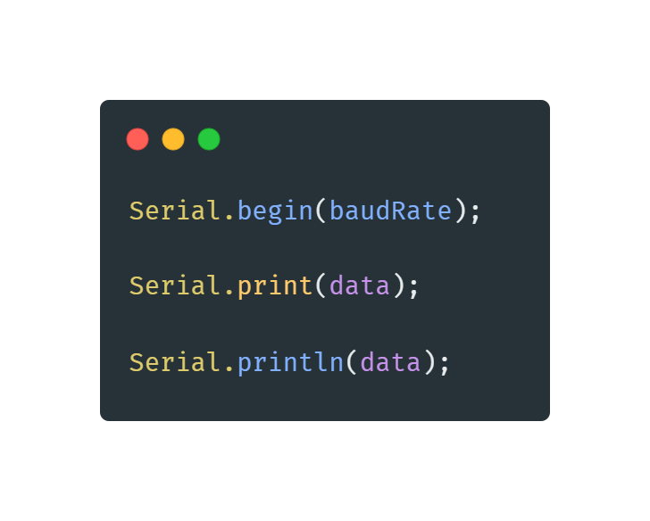
Common Functions Used in Arduino Programming
Serial.begin():
Purpose: Sets the data rate in bits per second (baud) for serial data transmission.
Serial.print():
Purpose: Prints data to the serial port as human-readable ASCII text.
Serial.println():
Purpose: Prints data to the serial port as human-readable ASCII text, followed by a carriage return character.

Slide 16
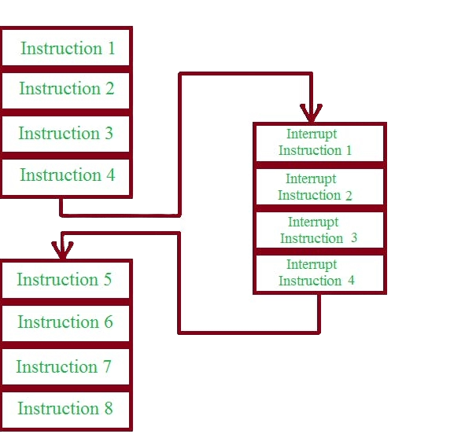
Interrupts
Definition
Interrupts are signals that temporarily halt the main program execution to immediately run a special function called an Interrupt Service Routine (ISR).
Purpose
To handle time-critical tasks, respond to external events, or process real-time signals without delay.
Benefits
Allows for efficient handling of tasks without continuously checking for events within the main loop.

Slide 17
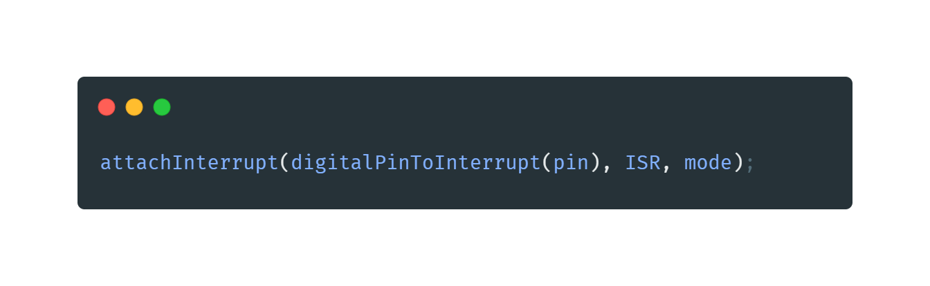
Using Interrupts in Arduino
Attaching an Interrupt:
Use the attachInterrupt() function to specify which pin and condition will trigger the interrupt, and which ISR to call.
Parameters:
pin: The pin number where the interrupt is attached.
ISR: The name of the function to call when the interrupt occurs.
mode: The condition that triggers the interrupt (LOW, CHANGE, RISING, FALLING).

Slide 18
Example:

Slide 19
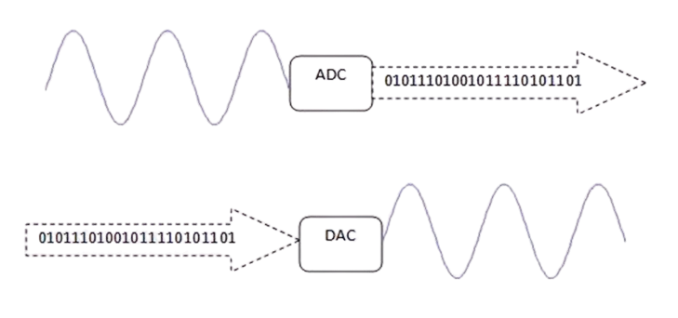
ADC & DAC

Slide 20
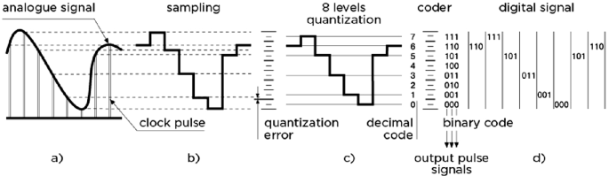
How ADC Works
Sampling: The analog signal is sampled at regular intervals.
Quantization: Each sample is approximated to the nearest value within a range.
Encoding: The quantized values are converted into binary code.

Slide 21
What is an ADC?
Definition: An Analog-to-Digital Converter (ADC) is a device that converts analog signals (continuous signals) into digital signals (discrete signals) that a microcontroller or computer can process.
Purpose: To allow digital systems to interact with the real world by converting analog inputs (e.g., temperature, sound, light) into a format they can understand and process.
What is a DAC?
Definition: A Digital-to-Analog Converter (DAC) is a device that converts digital signals (discrete signals) into analog signals (continuous signals).
Purpose: To allow digital systems to produce analog outputs (e.g., audio signals, light intensity control) that can be used in the real world.

Slide 22
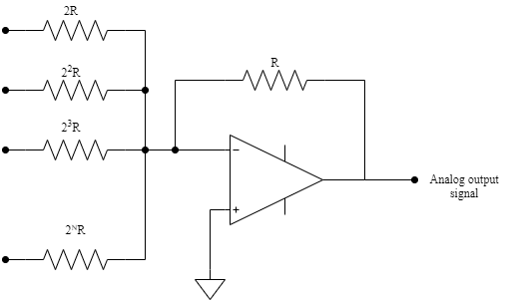
How DAC Works
Input: The digital signal is received from a microcontroller or computer.
Conversion: The digital values are converted to corresponding analog values.
Output: The analog signal is output to drive an analog device.

Slide 23
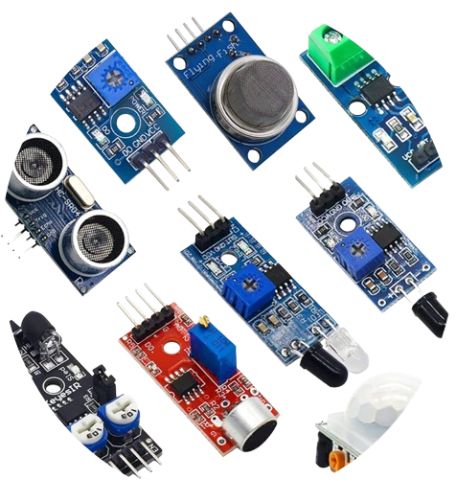
Sensors

Slide 24
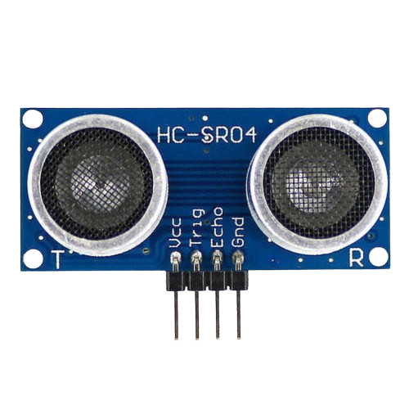
Ultrasonic Sensor
Introduction:
Definition: Ultrasonic sensors use sound waves to measure the distance between the sensor and an object.
Common Model: HC-SR04.
Working Principle:
Sound Waves: Sends out an ultrasonic wave and measures the time it takes for the echo to return.
Distance Calculation: Uses the speed of sound to calculate distance based on the time it took for the echo to return.

Slide 25
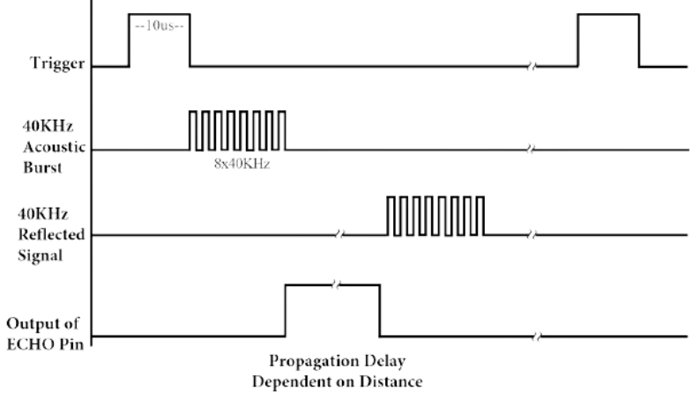
Pin Configuration
VCC: +5V Power Supply
GND: Ground
Trig: Trigger Pin
Echo: Echo Pin

Slide 26
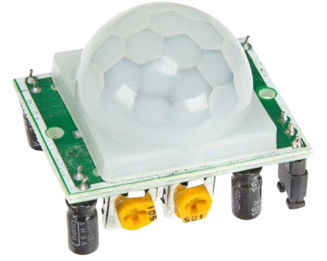
PIR (Passive Infrared) Sensor
Introduction:
Definition: PIR sensors detect motion by measuring infrared radiation from objects in their field of view.
Common Usage: Security systems, automatic lighting.
Working Principle:
Infrared Detection: Detects changes in infrared radiation, indicating movement of people or animals.

Slide 27
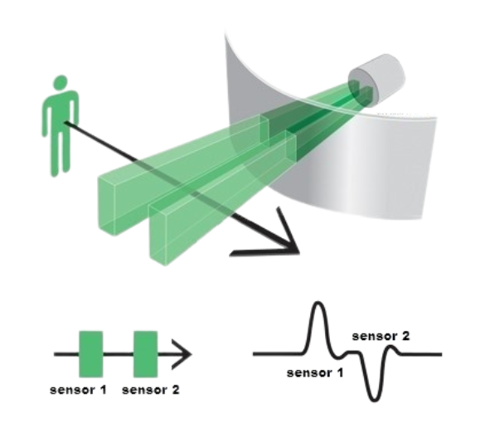
Pin Configuration
VCC: +5V Power Supply
GND: Ground
OUT: Output Signal

Slide 28
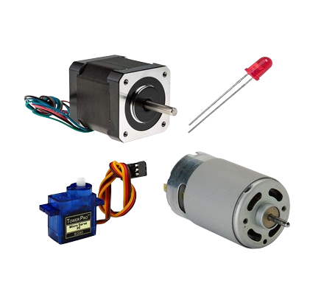
Actuators

Slide 29
Actuators
Definition: Actuators are devices that convert electrical energy into physical motion. They are used to move or control mechanisms or systems.
Common Types: Servos, DC motors, stepper motors.

Slide 30
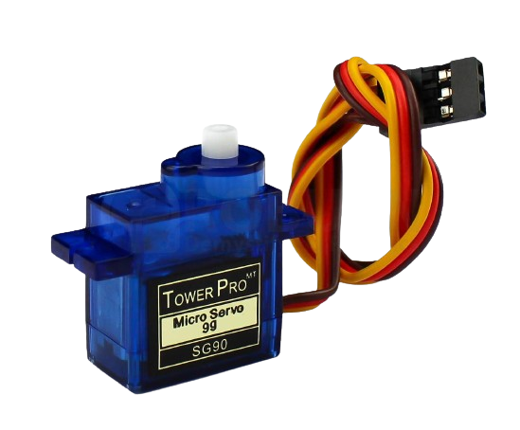
Servo Motors
Definition: Servo motors are precise control motors that use a feedback loop to control position, speed, and acceleration.
Common Use: Robotics, RC cars, controlled positioning systems.

Slide 31
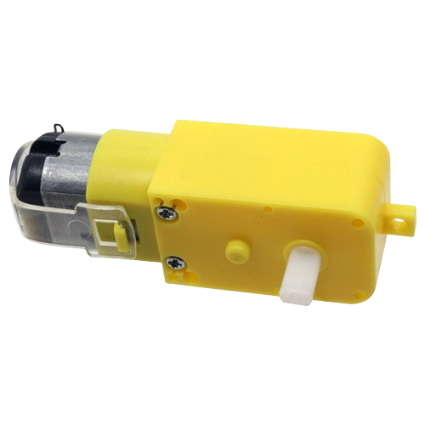
DC Motors
Definition: DC motors convert direct current electrical energy into mechanical motion.
Common Use: Fans, wheels in robots, small appliances.

Slide 32
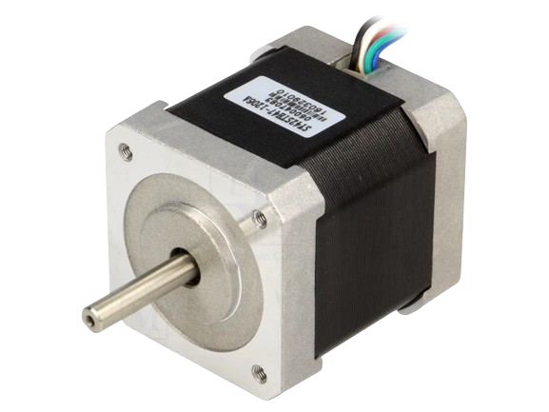
Stepper Motors
Definition: Stepper motors move in discrete steps, offering precise control over movement.
Common Use: 3D printers, CNC machines, camera platforms.

Slide 33
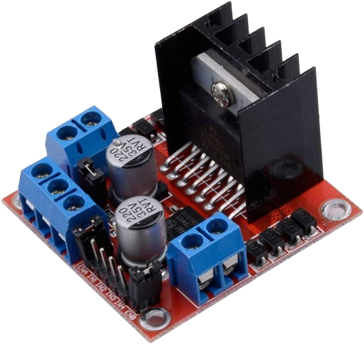
H-Bridge
Introduction:
Definition: An H-Bridge is an electronic circuit that enables a voltage to be applied across a load in either direction.
Common Use: Motor control, allowing motors to run forward or backward.
Working Principle:
Configuration: Consists of four switches (transistors or MOSFETs) that control the direction of current flow.
Direction Control: By closing different pairs of switches, the direction of the current and thus the motor's direction can be controlled.

Slide 34
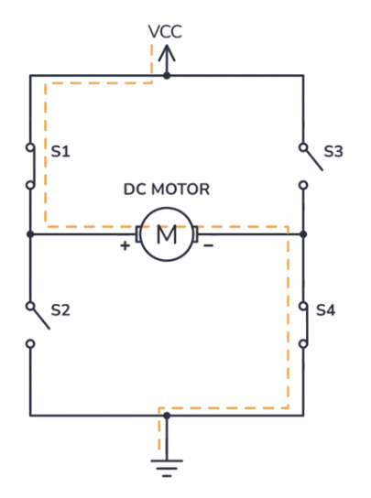
Pin Configuration
IN1, IN2, IN3, IN4: Input pins to control the switches.
ENA, ENB: Enable pins to activate the H-Bridge channels.
OUT1, OUT2, OUT3, OUT4: Output pins connected to the motor.
VCC: Voltage supply for the H-Bridge.
GND: Ground.12V: Power supply for the motors.

Slide 35
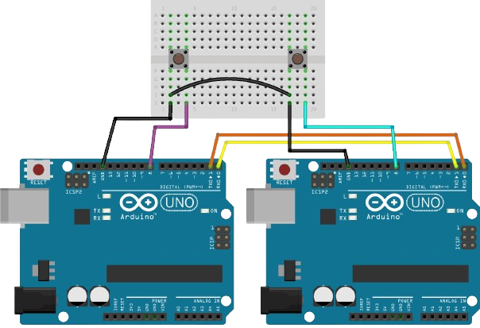
Communication

Slide 36

Examples

Slide 37

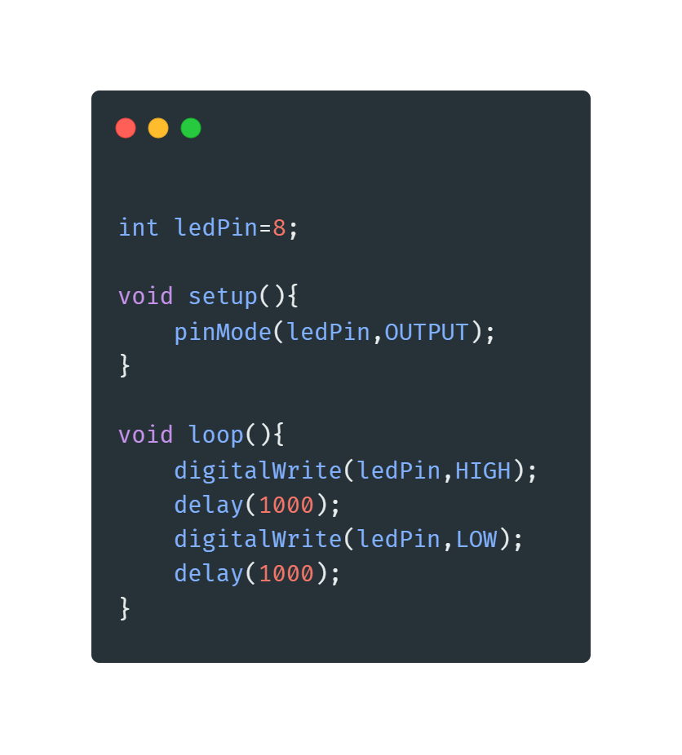
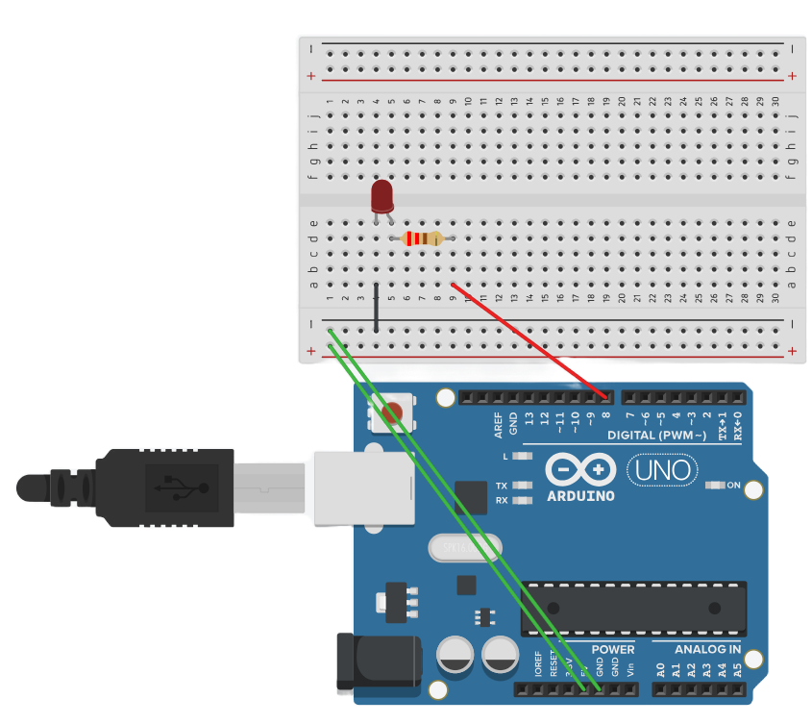
Example 1 => Blinking LED
Blinking LED using Delay function:

Slide 38
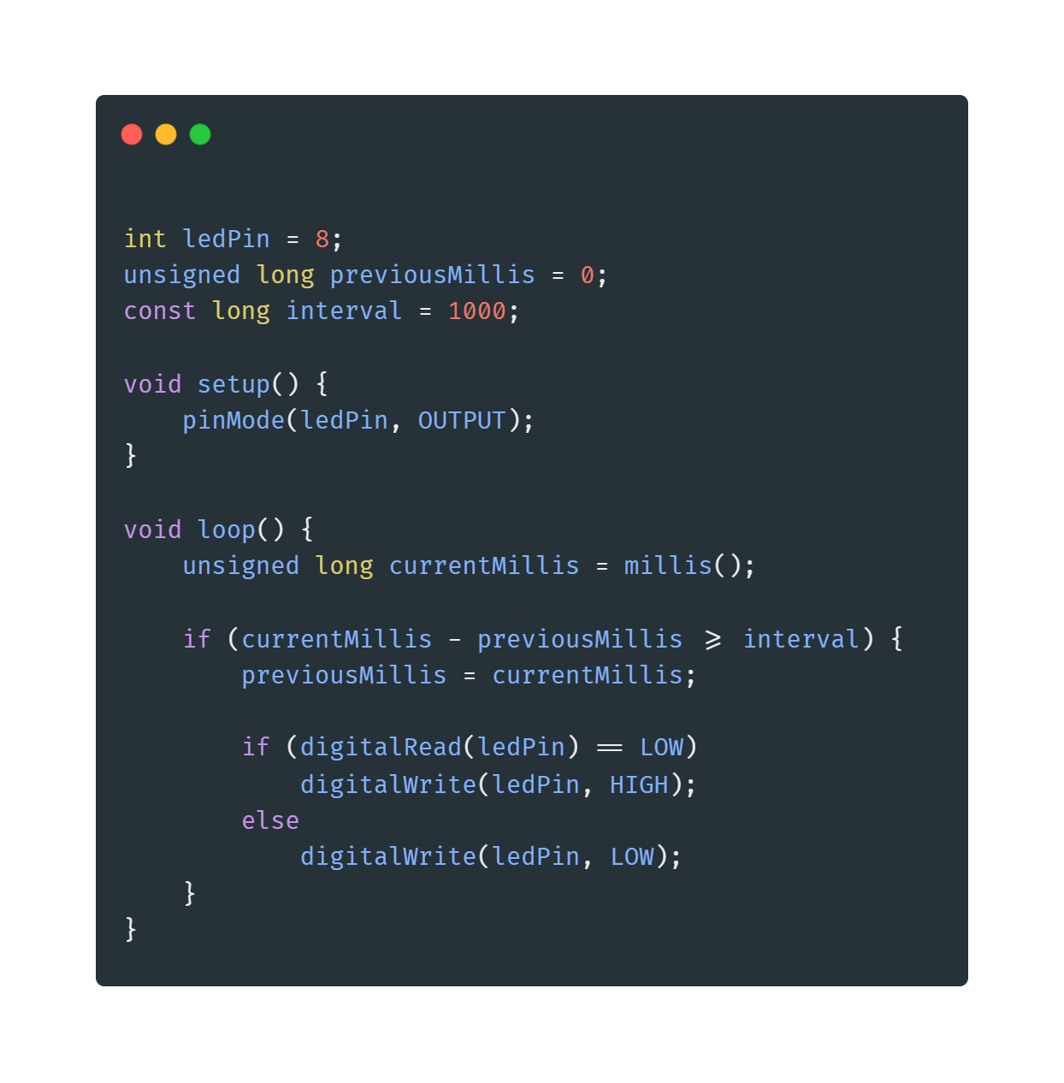
Example 2 => Blinking LED
Blinking LED using millis function:

Slide 39
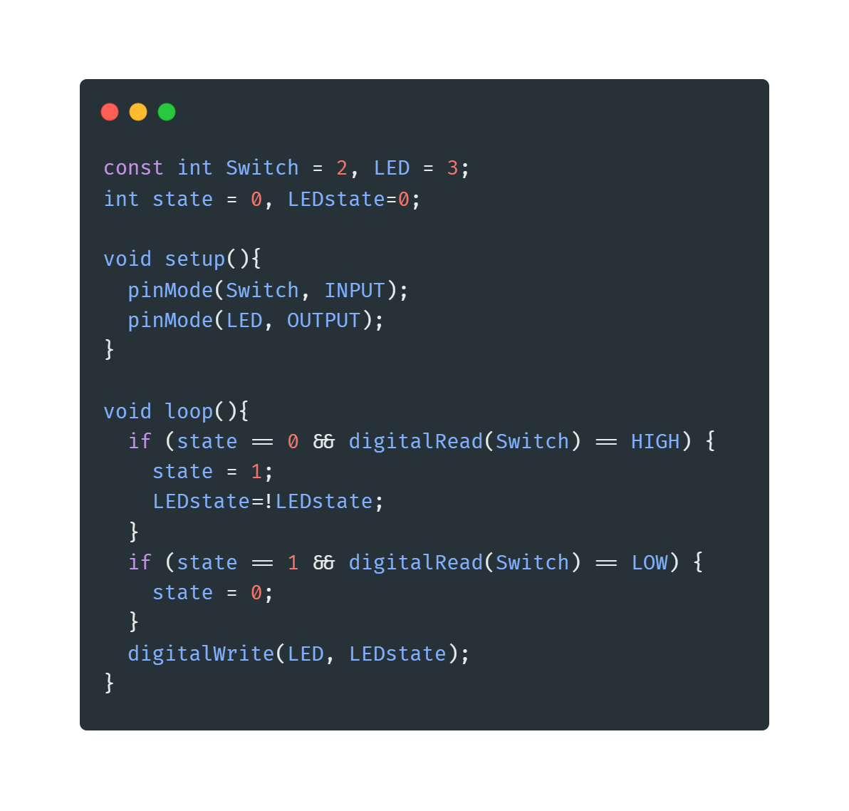
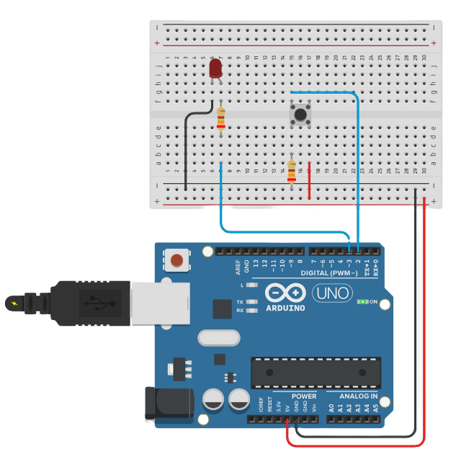
Example 3 => Toggle LED
Toggle LED without interrupts:

Slide 40
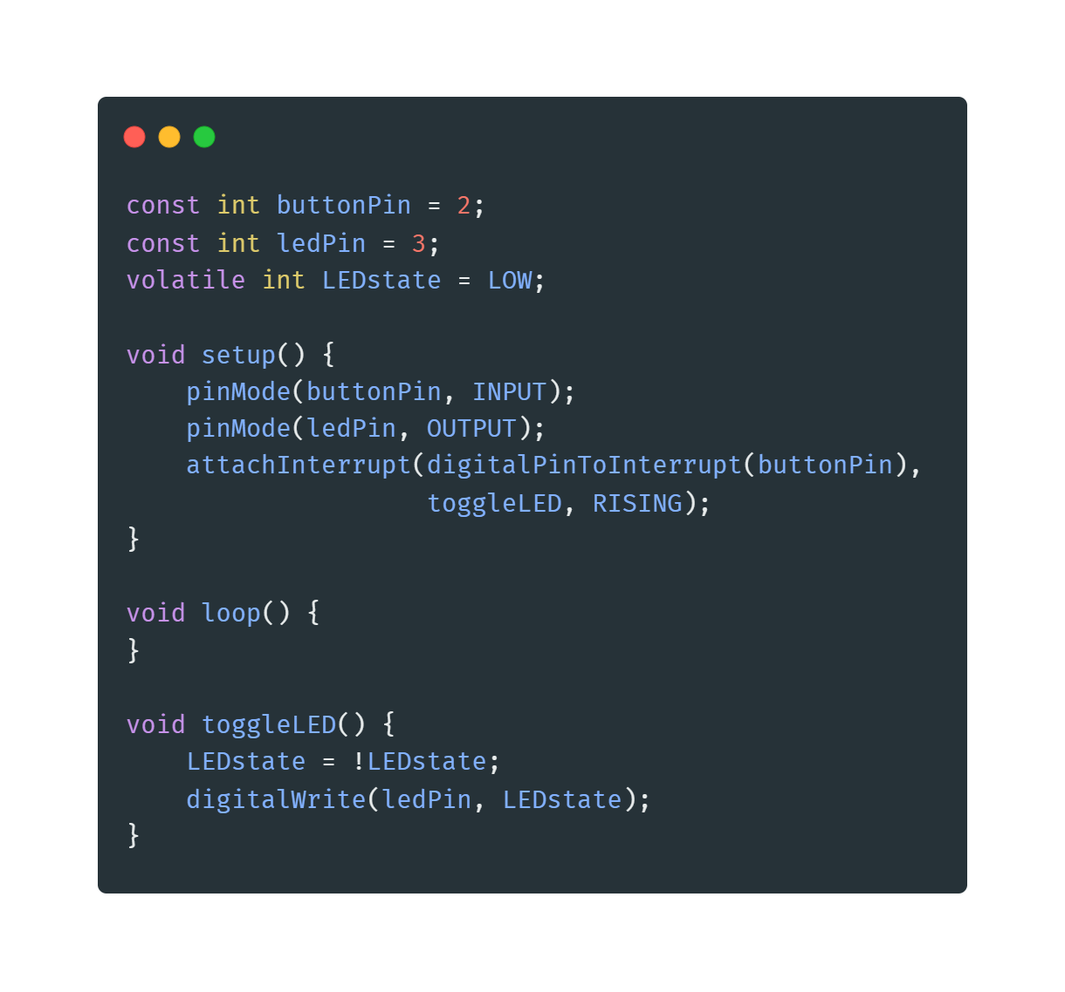
Example 4 => Toggle LED
Toggle LED with interrupts:

Slide 41
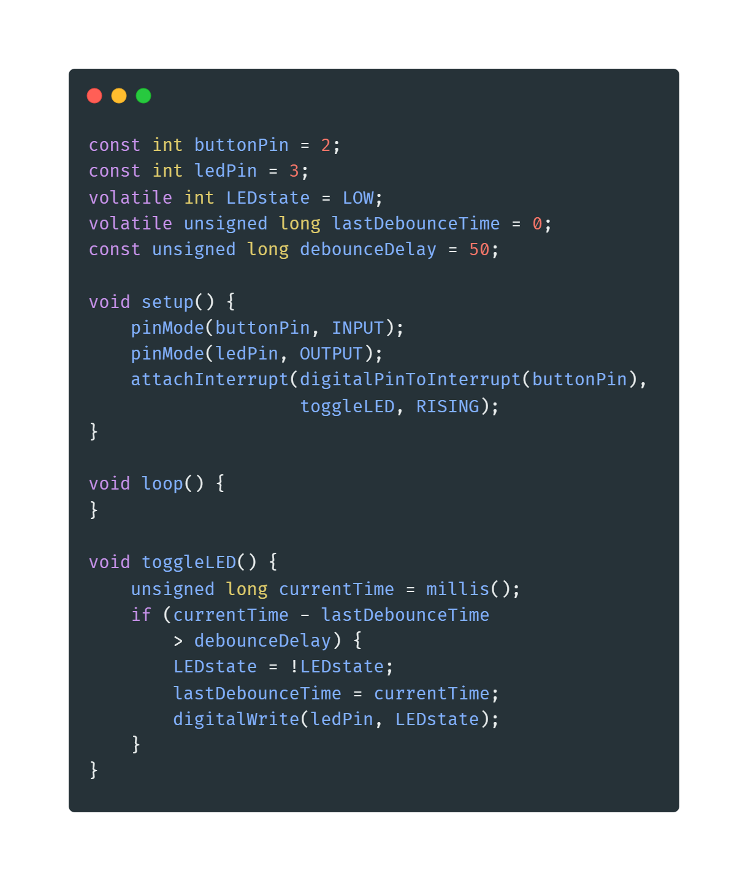
Example 5 => Toggle LED
Toggle LED with interrupts and avoid bouncing effect:

Slide 42
Example 6 => Controlling LED
Creating an interactive system using an Arduino that involves the following components:
Potentiometer
Button
LED
Requirements:
The potentiometer should control the brightness of the LED.
Button should toggle the LED on and off.
Use interrupts to handle the button presses efficiently.

Slide 43
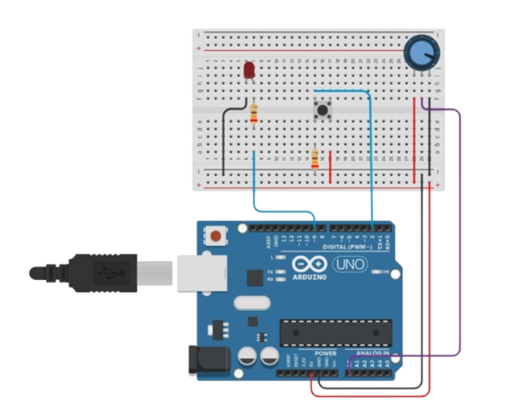
Example 6 => Controlling LED

Slide 44
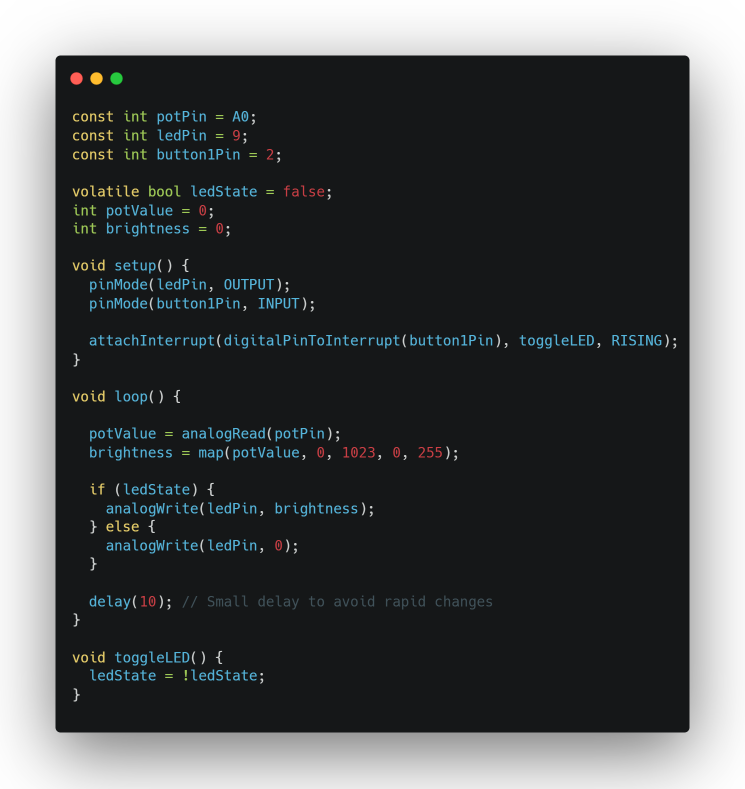
Example 6 => Controlling LED

Slide 45
Example 7 => Controlling Array of LEDs Unsolved example
You need to create an Arduino system that controls four LEDs based on the value of a potentiometer.
Requirements:Use a potentiometer to determine how many LEDs should be turned on.
The system should work as follows:
If the potentiometer value is between 0 and 255, turn on 1 LED.
If the potentiometer value is between 256 and 511, turn on 2 LEDs.
If the potentiometer value is between 512 and 767, turn on 3 LEDs.
If the potentiometer value is between 768 and 1023, turn on all 4 LEDs.

Slide 46
Example 8 => LED Reaction Game Unsolved example
Design an Arduino-based reaction game that uses LEDs, a potentiometer, and a button. The goal of the game is to test the player's reaction time.
Requirements:
Use a potentiometer to set the difficulty level of the game.
An LED should light up randomly after a delay.
The player must press a button as quickly as possible when the LED lights up.
The system should display the player's reaction time using LEDs.
The game should reset automatically after displaying the reaction time.

Slide 47
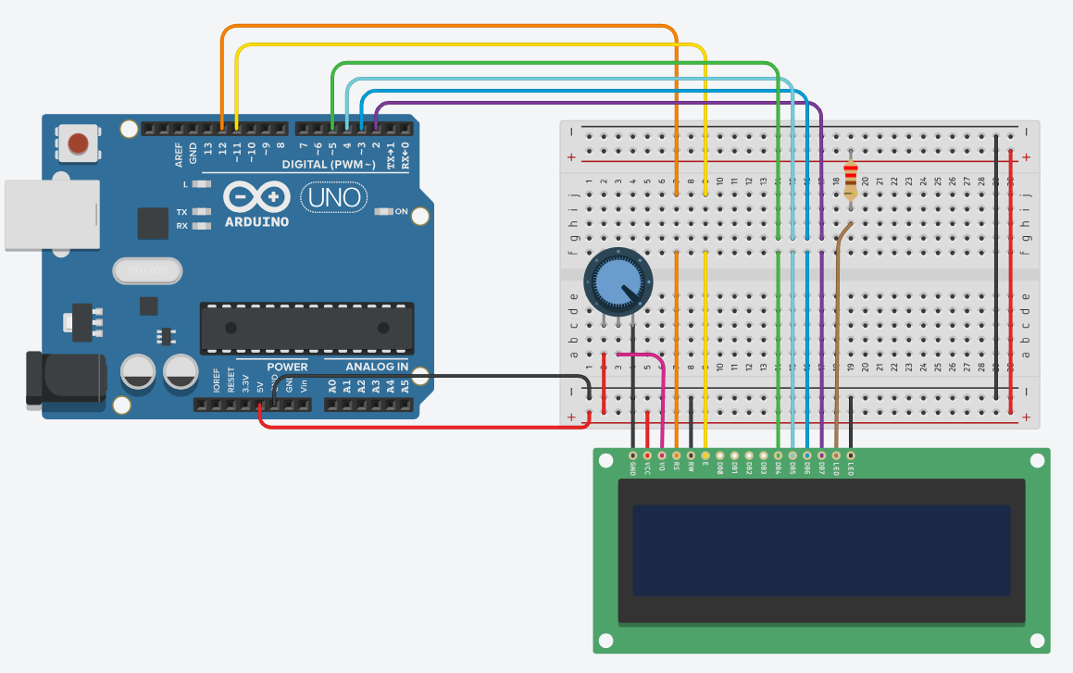
Example 9 => Print Your Name

Slide 48
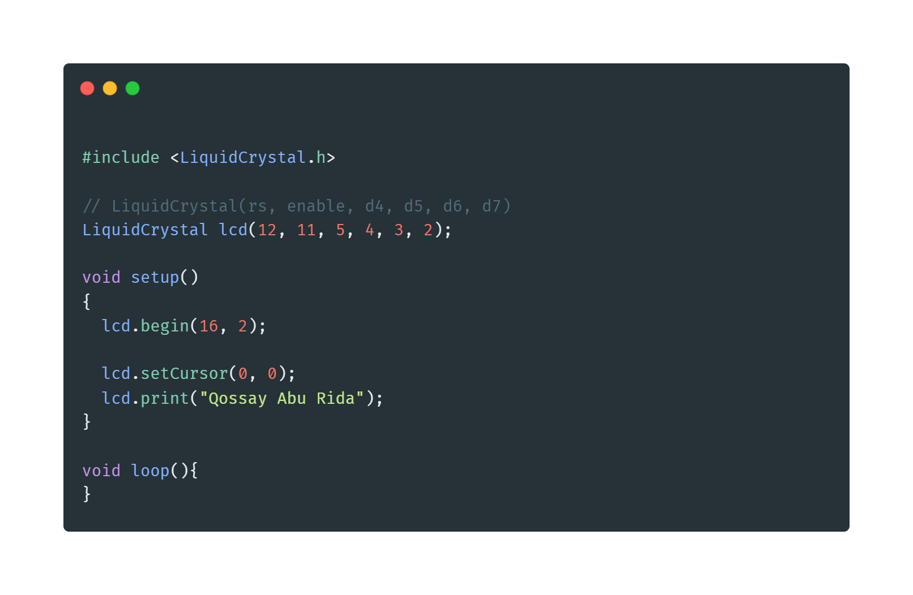
Example 9 => Print Your Name

Slide 49
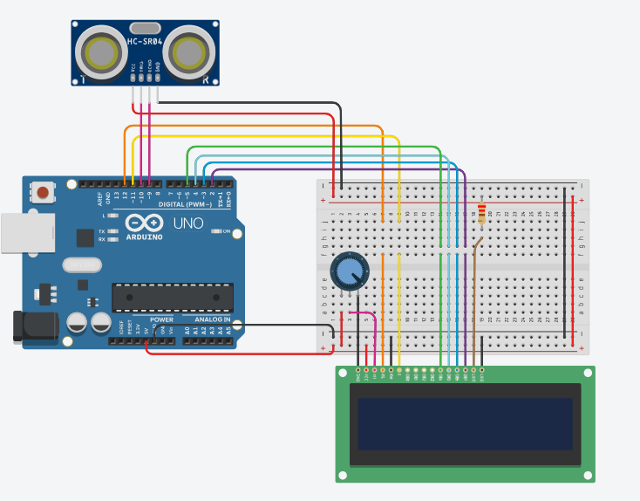
Example 10 => Distance Measurement

Slide 50
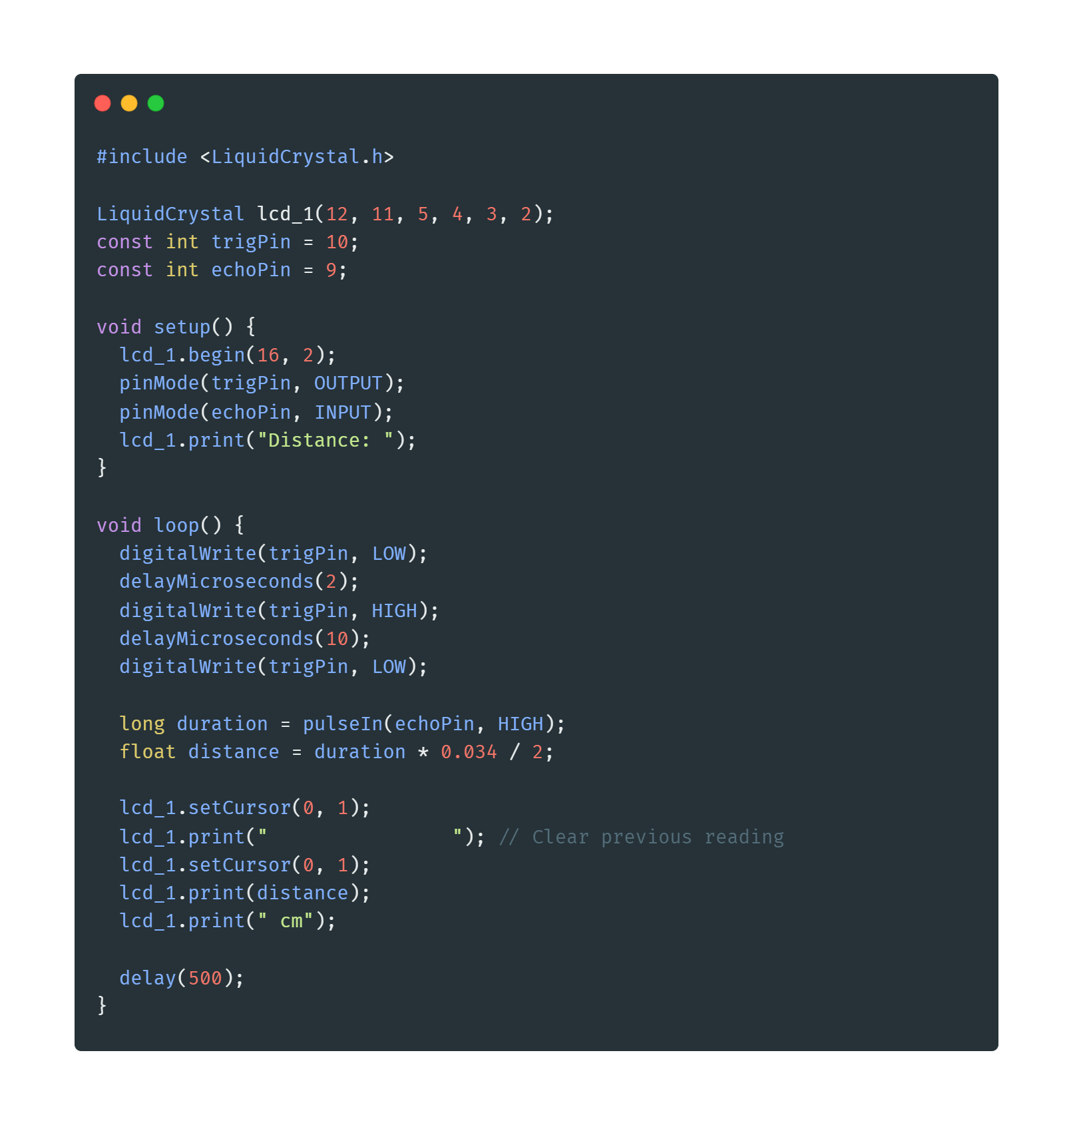
Example 10 => Distance Measurement
The speed of sound in air is approximately 343 meters per second or 0.0343 centimeters per microsecond.

Slide 51
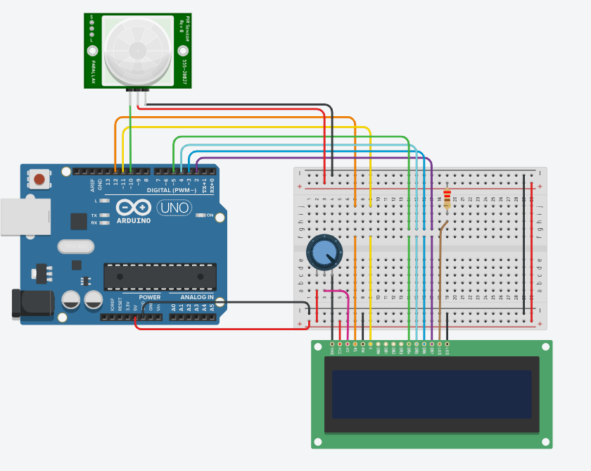
Example 11 => Motion detection

Slide 52
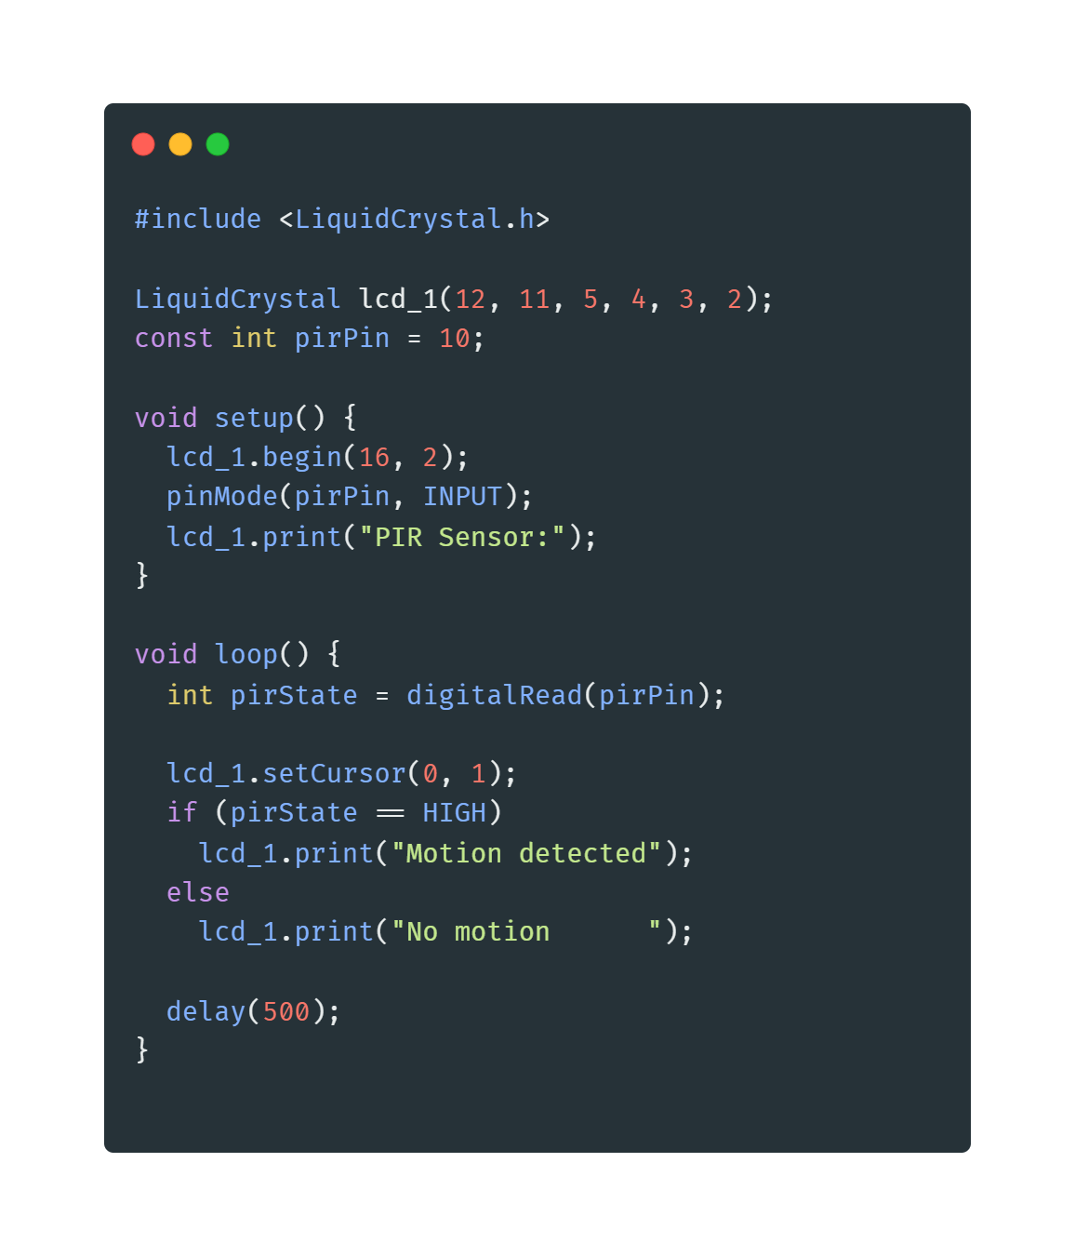
Example 11 => Motion detection

Slide 53
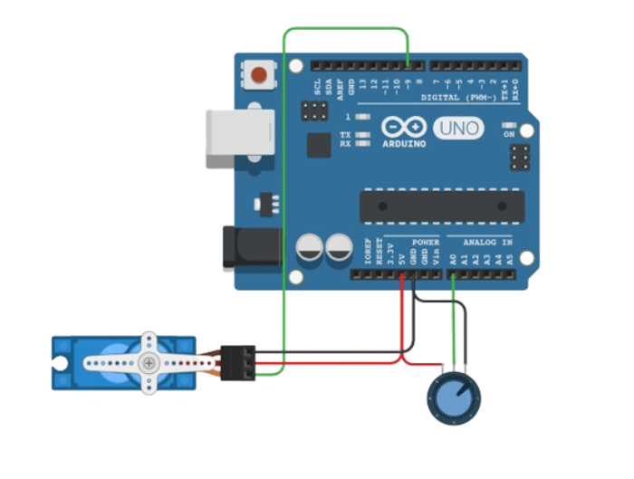
Example 12 => Servo Motors

Slide 54
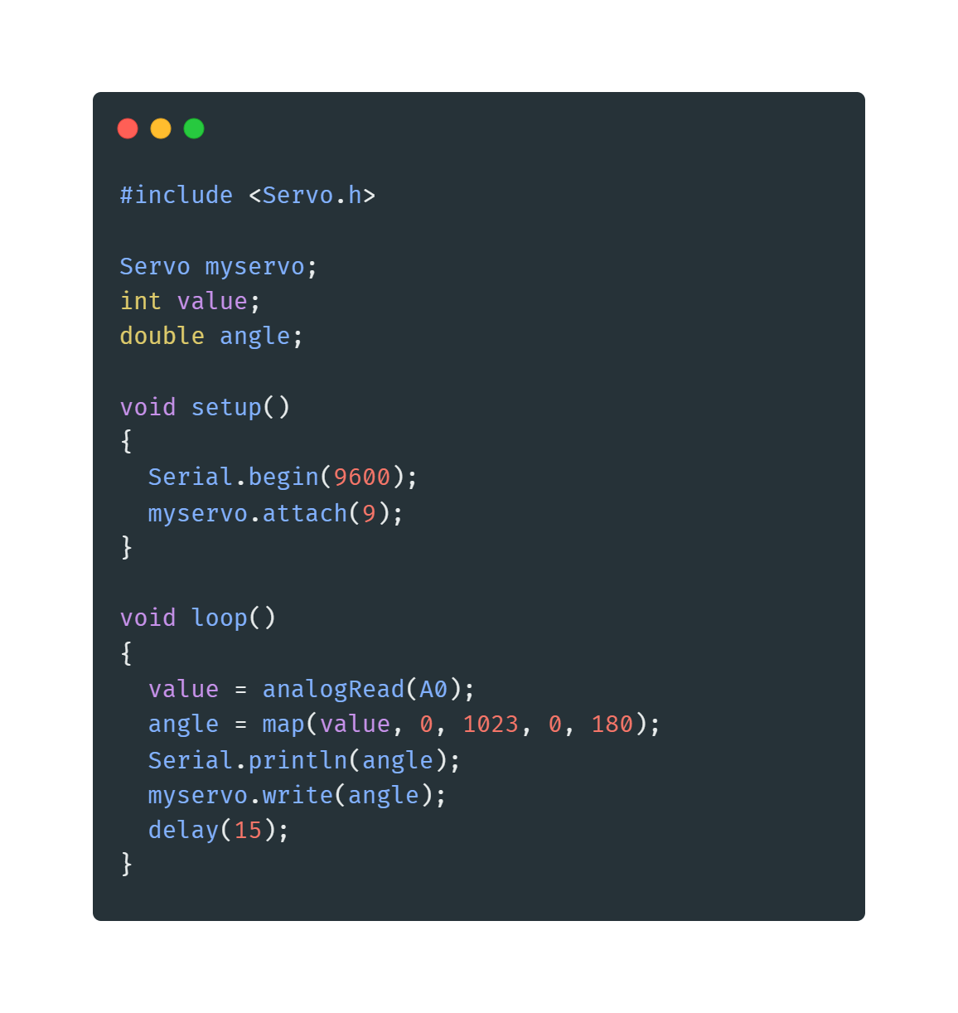
Example 12 => Servo Motors

Slide 55
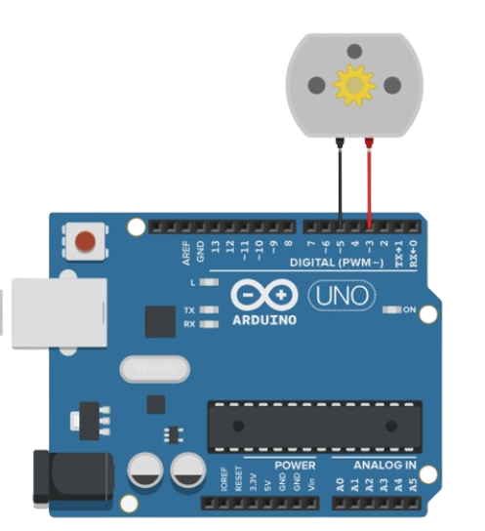
Example 13 => DC Motors

Slide 56
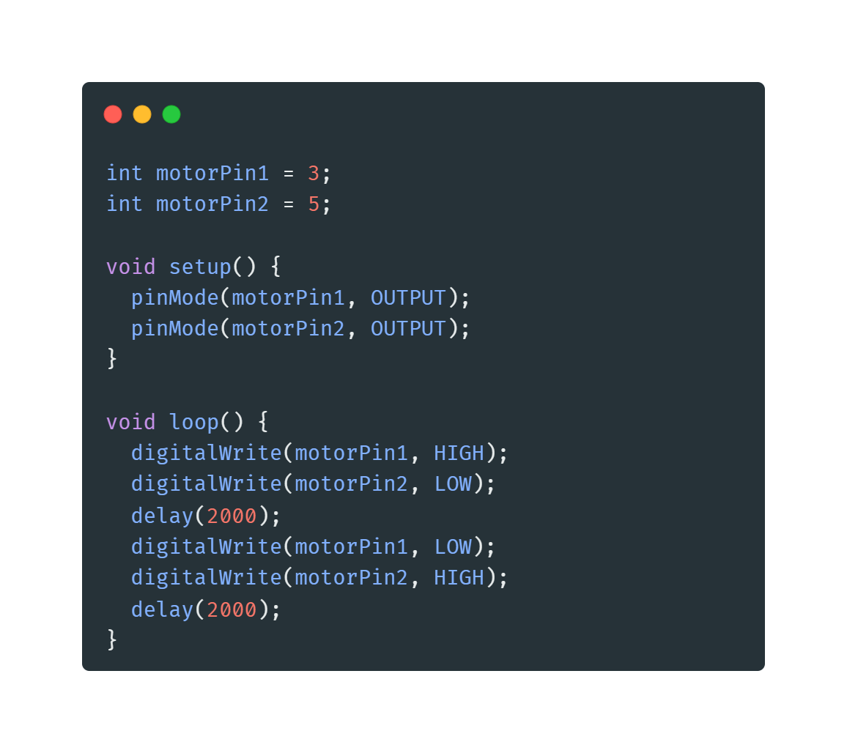
Example 13 => DC Motors

Slide 57
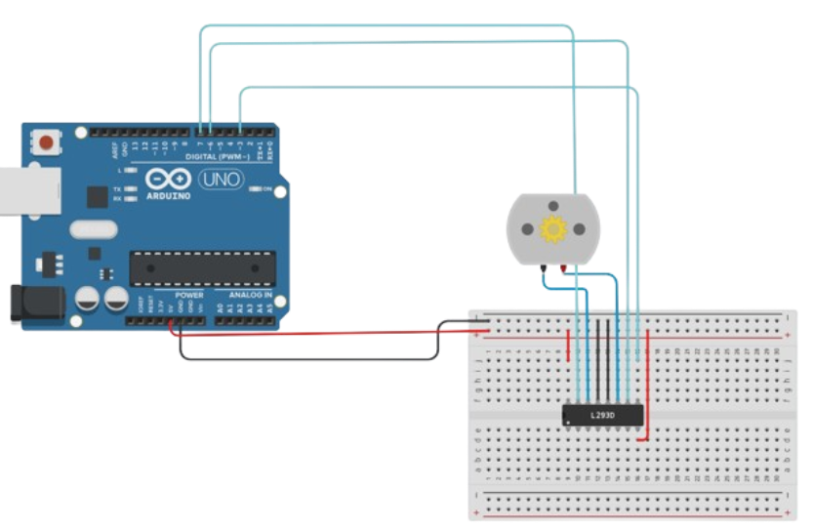
Example 14 => H-Bridge

Slide 58
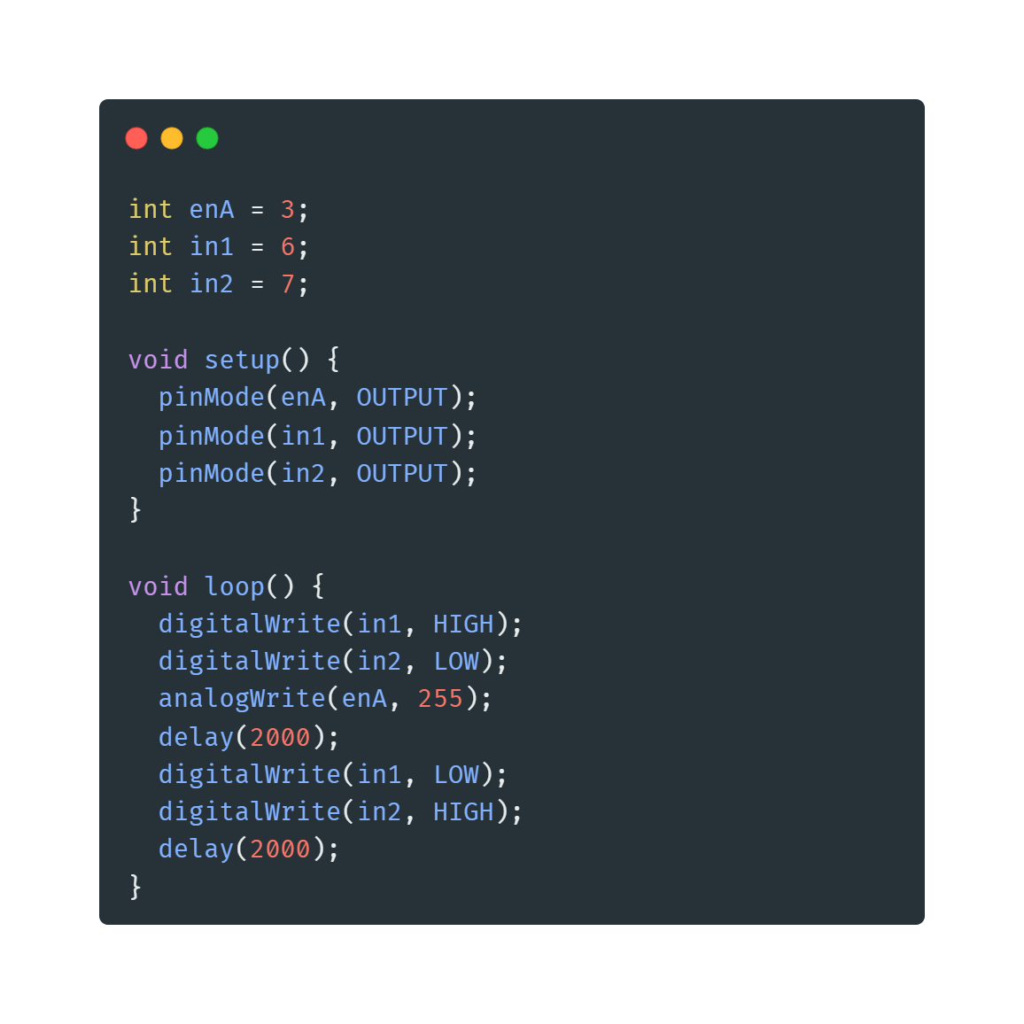
Example 14 => H-Bridge

Slide 59




Contact us

